Slide 1
CMSC 671
Fall 2010
Class #12/13 – Wednesday, October 13/
Monday, October 18
Some material adapted from slides by
Jean-Claude Latombe / Lise Getoor

Slide 2
Planning
Chapter 10
Some material adopted from notes by Andreas Geyer-Schulz
and Chuck Dyer

Slide 3
Today’s class
What is planning?
Approaches to planning
  GPS / STRIPS
  Situation calculus formalism [revisited]
  Partial-order planning
  Graph-based planning
  Satisfiability planning

Slide 4
Planning problem
Find a sequence of actions that achieves a given goal when executed from a given initial world state. That is, given
  a set of operator descriptions (defining the possible primitive actions by the agent),
  an initial state description, and
  a goal state description or predicate,
compute a plan, which is
  a sequence of operator instances, such that executing them in the initial state will change the world to a state satisfying the goal-state description.
Goals are usually specified as a conjunction of goals to be achieved

Slide 5
Planning vs. problem solving
Planning and problem solving methods can often solve the same sorts of problems
Planning is more powerful because of the representations and methods used
States, goals, and actions are decomposed into sets of sentences (usually in first-order logic)
Search often proceeds through plan space rather than state space (though there are also state-space planners)
Subgoals can be planned independently, reducing the complexity of the planning problem

Slide 6
Typical assumptions
Atomic time: Each action is indivisible
No concurrent actions are allowed (though actions do not need to be ordered with respect to each other in the plan)
Deterministic actions: The result of actions are completely determined—there is no uncertainty in their effects
Agent is the sole cause of change in the world
Agent is omniscient: Has complete knowledge of the state of the world
Closed world assumption: everything known to be true in the world is included in the state description. Anything not listed is false.

Slide 7
Blocks world
The blocks world is a micro-world that consists of a table, a set of blocks and a robot hand.
Some domain constraints:
  Only one block can be on another block
  Any number of blocks can be on the table
  The hand can only hold one block
Typical representation:
  ontable(a)
  ontable(c)
  on(b,a)
  handempty
  clear(b)
  clear(c)
B
A
C
TABLE

Slide 8
Major approaches
GPS / STRIPS
Situation calculus
Partial-order planning
Planning with constraints (SATplan, Graphplan)
Hierarchical decomposition (HTN planning)
Reactive planning

Slide 9
General Problem Solver
The General Problem Solver (GPS) system was an early planner (Newell, Shaw, and Simon)
GPS generated actions that reduced the difference between some state and a goal state
GPS used Means-Ends Analysis
  Compare what is given or known with what is desired and select a reasonable thing to do next
  Use a table of differences to identify procedures to reduce types of differences
GPS was a state space planner: it operated in the domain of state space problems specified by an initial state, some goal states, and a set of operations

Slide 10
Situation calculus planning
Intuition: Represent the planning problem using first-order logic
  Situation calculus lets us reason about changes in the world
  Use theorem proving to “prove” that a particular sequence of actions, when applied to the situation characterizing the world state, will lead to a desired result

Slide 11
Situation calculus
Initial state: a logical sentence about (situation) S₀
  At(Home, S₀) ∧ ¬Have(Milk, S₀) ∧ ¬ Have(Bananas, S₀) ∧ ¬ Have(Drill, S₀)
Goal state:
  (∃s) At(Home,s) ∧ Have(Milk,s) ∧ Have(Bananas,s) ∧ Have(Drill,s)
Operators are descriptions of how the world changes as a result of the agent’s actions:
  ∀(a,s) Have(Milk,Result(a,s)) ⇔
  ((a=Buy(Milk) ∧ At(Grocery,s)) ∨ (Have(Milk, s) ∧ a ≠ Drop(Milk)))
Result(a,s) names the situation resulting from executing action a in situation s.
Action sequences are also useful: Result'(l,s) is the result of executing the list of actions (l) starting in s:
  (∀s) Result'([],s) = s
  (∀a,p,s) Result'([a|p]s) = Result'(p,Result(a,s))

Slide 12
Situation calculus II
A solution is a plan that when applied to the initial state yields a situation satisfying the goal query:
  At(Home, Result'(p,S₀))
  ∧ Have(Milk, Result'(p,S₀))
  ∧ Have(Bananas, Result'(p,S₀))
  ∧ Have(Drill, Result'(p,S₀))
Thus we would expect a plan (i.e., variable assignment through unification) such as:
  p = [Go(Grocery), Buy(Milk), Buy(Bananas), Go(HardwareStore),
  Buy(Drill), Go(Home)]

Slide 13
Situation calculus: Blocks world
Here’s an example of a situation calculus rule for the blocks world:
  Clear (X, Result(A,S)) ↔
  [Clear (X, S) ∧
  (¬(A=Stack(Y,X) ∨ A=Pickup(X))
  ∨ (A=Stack(Y,X) ∧ ¬(holding(Y,S))
  ∨ (A=Pickup(X) ∧ ¬(handempty(S) ∧ ontable(X,S) ∧ clear(X,S))))]
  ∨ [A=Stack(X,Y) ∧ holding(X,S) ∧ clear(Y,S)]
  ∨ [A=Unstack(Y,X) ∧ on(Y,X,S) ∧ clear(Y,S) ∧ handempty(S)]
  ∨ [A=Putdown(X) ∧ holding(X,S)]
English translation: A block is clear if (a) in the previous state it was clear and we didn’t pick it up or stack something on it successfully, or (b) we stacked it on something else successfully, or (c) something was on it that we unstacked successfully, or (d) we were holding it and we put it down.
Whew!!! There’s gotta be a better way!

Slide 14
Situation calculus planning: Analysis
This is fine in theory, but remember that problem solving (search) is exponential in the worst case
Also, resolution theorem proving only finds a proof (plan), not necessarily a good plan
So we restrict the language and use a special-purpose algorithm (a planner) rather than general theorem prover

Slide 15
Basic representations for planning
Classic approach first used in the STRIPS planner circa 1970
States represented as a conjunction of ground literals
  at(Home) ∧ ¬have(Milk) ∧ ¬have(bananas) ...
Goals are conjunctions of literals, but may have variables which are assumed to be existentially quantified
  at(?x) ∧ have(Milk) ∧ have(bananas) ...
Do not need to fully specify state
  Non-specified either don’t-care or assumed false
  Represent many cases in small storage
  Often only represent changes in state rather than entire situation
Unlike theorem prover, not seeking whether the goal is true, but is there a sequence of actions to attain it

Slide 16
Operator/action representation
Operators contain three components:
  Action description
  Precondition - conjunction of positive literals
  Effect - conjunction of positive or negative literals which describe how situation changes when operator is applied
Example:
  Op[Action: Go(there),
  Precond: At(here) ∧ Path(here,there),
  Effect: At(there) ∧ ¬At(here)]
All variables are universally quantified
Situation variables are implicit
  Preconditions must be true in the state immediately before an operator is applied; effects are true immediately after
At(here) ,Path(here,there)
Go(there)
At(there) , ¬At(here)

Slide 17
Blocks world operators
Here are the classic basic operations for the blocks world:
  stack(X,Y): put block X on block Y
  unstack(X,Y): remove block X from block Y
  pickup(X): pickup block X
  putdown(X): put block X on the table
Each action will be represented by:
  a list of preconditions
  a list of new facts to be added (add-effects)
  a list of facts to be removed (delete-effects)
  optionally, a set of (simple) variable constraints
For example:
  preconditions(stack(X,Y), [holding(X), clear(Y)])
  deletes(stack(X,Y), [holding(X), clear(Y)]).
  adds(stack(X,Y), [handempty, on(X,Y), clear(X)])
  constraints(stack(X,Y), [X≠Y, Y≠table, X≠table])

Slide 18
Blocks world operators II
operator(stack(X,Y),
Precond [holding(X), clear(Y)],
Add [handempty, on(X,Y), clear(X)],
Delete [holding(X), clear(Y)],
Constr [X≠Y, Y≠table, X≠table]).
operator(pickup(X),
[ontable(X), clear(X), handempty],
[holding(X)],
[ontable(X), clear(X), handempty],
[X≠table]).
operator(unstack(X,Y),
[on(X,Y), clear(X), handempty],
[holding(X), clear(Y)],
[handempty, clear(X), on(X,Y)],
[X≠Y, Y≠table, X≠table]).
operator(putdown(X),
[holding(X)],
[ontable(X), handempty, clear(X)],
[holding(X)],
[X≠table]).

Slide 19
STRIPS planning
STRIPS maintains two additional data structures:
  State List - all currently true predicates.
  Goal Stack - a push-down stack of goals to be solved, with current goal on top of stack.
If current goal is not satisfied by present state, examine add lists of operators, and push operator and preconditions list on stack. (Subgoals)
When a current goal is satisfied, POP it from stack.
When an operator is on top of the stack, record the application of that operator in the plan sequence and use the operator’s add and delete lists to update the current state.

Slide 20
Typical BW planning problem
Initial state:
  clear(a)
  clear(b)
  clear(c)
  ontable(a)
  ontable(b)
  ontable(c)
  handempty
Goal:
  on(b,c)
  on(a,b)
  ontable(c)
A plan:
  pickup(b)
  stack(b,c)
  pickup(a)
  stack(a,b)
A
C
B
A
B
C

Slide 21
Another BW planning problem
Initial state:
  clear(a)
  clear(b)
  clear(c)
  ontable(a)
  ontable(b)
  ontable(c)
  handempty
Goal:
  on(a,b)
  on(b,c)
  ontable(c)
A plan:
  pickup(a)
stack(a,b)
unstack(a,b)
putdown(a)
pickup(b)
stack(b,c)
pickup(a)
stack(a,b)
A
C
B
A
B
C

Slide 22
Goal interaction
Simple planning algorithms assume that the goals to be achieved are independent
  Each can be solved separately and then the solutions concatenated
This planning problem, called the “Sussman Anomaly,” is the classic example of the goal interaction problem:
  Solving on(A,B) first (by doing unstack(C,A), stack(A,B) will be undone when solving the second goal on(B,C) (by doing unstack(A,B), stack(B,C)).
  Solving on(B,C) first will be undone when solving on(A,B)
Classic STRIPS could not handle this, although minor modifications can get it to do simple cases
A
C
B
A
B
C
Initial state
Goal state

Slide 23
Sussman Anomaly
Achieve on(a,b) via stack(a,b) with preconds: [holding(a),clear(b)]
|Achieve holding(a) via pickup(a) with preconds: [ontable(a),clear(a),handempty]
||Achieve clear(a) via unstack(_1584,a) with preconds: [on(_1584,a),clear(_1584),handempty]
||Applying unstack(c,a)
||Achieve handempty via putdown(_2691) with preconds: [holding(_2691)]
||Applying putdown(c)
|Applying pickup(a)
Applying stack(a,b)
Achieve on(b,c) via stack(b,c) with preconds: [holding(b),clear(c)]
|Achieve holding(b) via pickup(b) with preconds: [ontable(b),clear(b),handempty]
||Achieve clear(b) via unstack(_5625,b) with preconds: [on(_5625,b),clear(_5625),handempty]
||Applying unstack(a,b)
||Achieve handempty via putdown(_6648) with preconds: [holding(_6648)]
||Applying putdown(a)
|Applying pickup(b)
Applying stack(b,c)
Achieve on(a,b) via stack(a,b) with preconds: [holding(a),clear(b)]
|Achieve holding(a) via pickup(a) with preconds: [ontable(a),clear(a),handempty]
|Applying pickup(a)
Applying stack(a,b)
From [clear(b),clear(c),ontable(a),ontable(b),on(c,a),handempty]
To [on(a,b),on(b,c),ontable(c)]
Do:
unstack(c,a)
putdown(c)
pickup(a)
stack(a,b)
unstack(a,b)
putdown(a)
pickup(b)
stack(b,c)
pickup(a)
stack(a,b)
Goal state
A
Initial state
C
B
A
B
C

Slide 24
State-space planning
We initially have a space of situations (where you are, what you have, etc.)
The plan is a solution found by “searching” through the situations to get to the goal
A progression planner searches forward from initial state to goal state
A regression planner searches backward from the goal
  This works if operators have enough information to go both ways
  Ideally this leads to reduced branching: the planner is only considering things that are relevant to the goal

Slide 25
Planning heuristics
Just as with search, we need an admissible heuristic that we can apply to planning states
  Estimate of the distance (number of actions) to the goal
Planning typically uses relaxation to create heuristics
  Ignore all or selected preconditions
  Ignore delete lists (movement towards goal is never undone)
  Use state abstraction (group together “similar” states and treat them as though they are identical) – e.g., ignore fluents
  Assume subgoal independence (use max cost; or if subgoals actually are independent, can sum the costs)
  Use pattern databases to store exact solution costs of recurring subproblems

Slide 26
Plan-space planning
An alternative is to search through the space of plans, rather than situations.
Start from a partial plan which is expanded and refined until a complete plan that solves the problem is generated.
Refinement operators add constraints to the partial plan and modification operators for other changes.
We can still use STRIPS-style operators:
  Op(ACTION: RightShoe, PRECOND: RightSockOn, EFFECT: RightShoeOn)
  Op(ACTION: RightSock, EFFECT: RightSockOn)
  Op(ACTION: LeftShoe, PRECOND: LeftSockOn, EFFECT: LeftShoeOn)
  Op(ACTION: LeftSock, EFFECT: leftSockOn)
could result in a partial plan of
  [RightShoe, LeftShoe]

Slide 27
Partial-order planning
A linear planner builds a plan as a totally ordered sequence of plan steps
A non-linear planner (aka partial-order planner) builds up a plan as a set of steps with some temporal constraints
  constraints of the form S1<S2 if step S1 must comes before S2.
One refines a partially ordered plan (POP) by either:
  adding a new plan step, or
  adding a new constraint to the steps already in the plan.
A POP can be linearized (converted to a totally ordered plan) by topological sorting

Slide 28
Least commitment
Non-linear planners embody the principle of least commitment
  only choose actions, orderings, and variable bindings that are absolutely necessary, leaving other decisions till later
  avoids early commitment to decisions that don’t really matter
A linear planner always chooses to add a plan step in a particular place in the sequence
A non-linear planner chooses to add a step and possibly some temporal constraints

Slide 29
Non-linear plan
A non-linear plan consists of
  (1) A set of steps {S₁, S₂, S₃, S₄…}
    Each step has an operator description, preconditions and post-conditions
  (2) A set of causal links { … (S_{i},C,S_{j}) …}
    Meaning a purpose of step S_{i} is to achieve precondition C of step S_{j}
  (3) A set of ordering constraints { … S_{i}<S_{j} … }
    if step S_{i} must come before step S_{j}
A non-linear plan is complete iff
  Every step mentioned in (2) and (3) is in (1)
  If S_{j} has prerequisite C, then there exists a causal link in (2) of the form (S_{i},C,S_{j}) for some S_{i}
  If (S_{i},C,S_{j}) is in (2) and step S_{k} is in (1), and S_{k} threatens (S_{i},C,S_{j}) (makes C false), then (3) contains either S_{k}<S_{i} or S_{j}<S_{k}

Slide 30
The initial plan
Every plan starts the same way
S1:Start
Initial State
Goal State
S2:Finish

Slide 31
Trivial example
Operators:
  Op(ACTION: RightShoe, PRECOND: RightSockOn, EFFECT: RightShoeOn)
  Op(ACTION: RightSock, EFFECT: RightSockOn)
  Op(ACTION: LeftShoe, PRECOND: LeftSockOn, EFFECT: LeftShoeOn)
  Op(ACTION: LeftSock, EFFECT: leftSockOn)
S1:Start
Steps: {S1:[Op(Action:Start)],
S2:[Op(Action:Finish,
Pre: RightShoeOn^LeftShoeOn)]}
Links: {}
Orderings: {S1<S2}
RightShoeOn ^ LeftShoeOn
S2:Finish

Slide 32
Solution
Start
Left
Sock
Right
Sock
Left
Shoe
Right
Shoe
Finish

Slide 33
POP constraints and search heuristics
Only add steps that achieve a currently unachieved precondition
Use a least-commitment approach:
  Don’t order steps unless they need to be ordered
Honor causal links S₁ → S₂ that protect a condition c:
  Never add an intervening step S₃ that violates c
  If a parallel action threatens c (i.e., has the effect of negating or clobbering c), resolve that threat by adding ordering links:
    Order S₃ before S₁ (demotion)
    Order S₃ after S₂ (promotion)
c

Slide 34
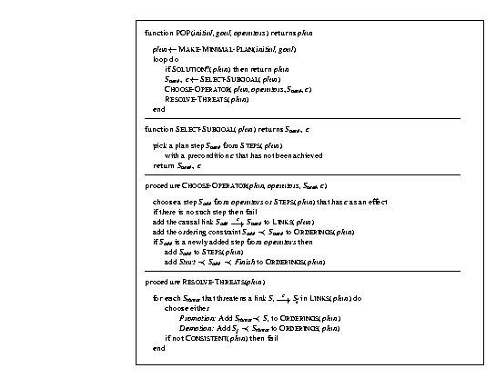

Slide 35
Partial-order planning algorithm
Create a START node with the initial state as its effects
Create a GOAL node with the goal as its preconditions
Create an ordering link from START to GOAL
While there are unsatisfied preconditions:
  Choose a precondition to satisfy
  Choose an existing action or insert a new action whose effect satisfies the precondition
    (If no such action, backtrack!)
  Insert a causal link from the chosen action’s effect to the precondition
  Resolve any new threats
    (If not possible, backtrack!)

Slide 36
Partial-order planning example
Goal: Have milk, bananas, and a drill
  Have(Milk) ∧ Have(Bananas) ∧ Have(Drill)
Operators:
  Op(ACTION: Buy(Item), PRECOND: At(Store) ∧ Sells(Store,Item),
  EFFECT: Have(Item))
  Op(ACTION: Go(Dest), PRECOND: At(Source),
  EFFECT: At(Dest) ∧ ~At(Source)
Initial state:
  At(Home) ∧ Sells(SM, Milk) ∧ Sells(SM, Bananas) ∧ Sells(HW, Drill)

Slide 37
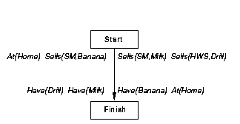

Slide 38
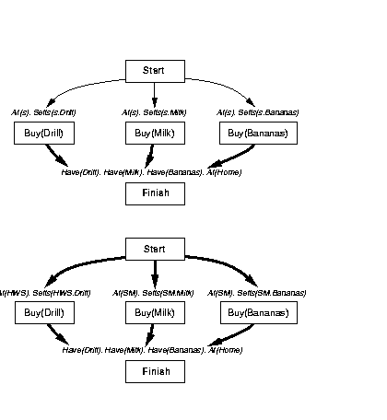

Slide 39
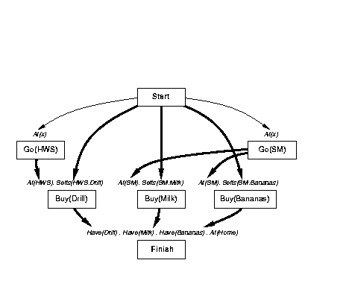

Slide 40
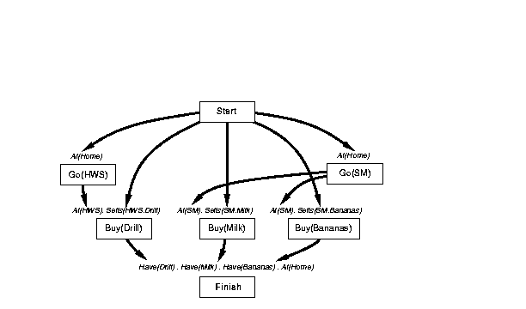

Slide 41
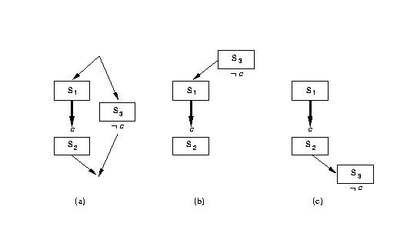
Resolving threats
Threat
Demotion
Promotion

Slide 42
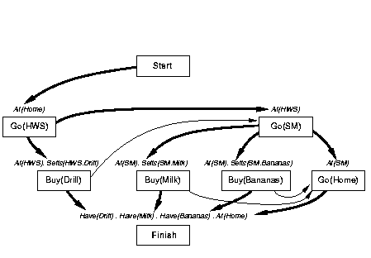

Slide 43
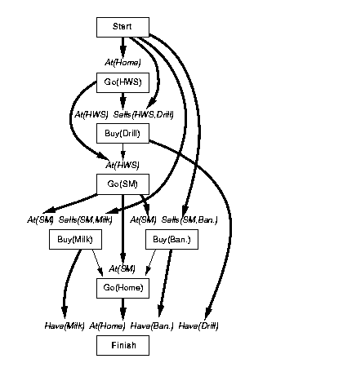

Slide 44
GraphPlan

Slide 45
GraphPlan: Basic idea
Construct a graph that encodes constraints on possible plans
Use this “planning graph” to constrain search for a valid plan
Planning graph can be built for each problem in a relatively short time

Slide 46
Planning graph
Directed, leveled graph with alternating layers of nodes
Odd layers (“state levels”) represent candidate propositions that could possibly hold at step i
Even layers (“action levels”) represent candidate actions that could possibly be executed at step i, including maintenance actions [do nothing]
Arcs represent preconditions, adds and deletes
We can only execute one real action at any step, but the data structure keeps track of all actions and states that are possible

Slide 47
GraphPlan properties
STRIPS operators: conjunctive preconditions, no conditional or universal effects, no negations
  Planning problem must be convertible to propositional representation
  Can’t handle continuous variables, temporal constraints, …
  Problem size grows exponentially
Finds “shortest” plans (by some definition)
Sound, complete, and will terminate with failure if there is no plan

Slide 48
What actions and what literals?
Add an action in level A_{i} if all of its preconditions are present in level S_{i}
Add a literal in level S_{i} if it is the effect of some action in level A_{i-1} (including no-ops)
Level S₀ has all of the literals from the initial state

Slide 49
Simple domain
Literals:
  at X Y X is at location Y
  fuel R rocket R has fuel
  in X R X is in rocket R
Actions:
  load X L load X (onto R) at location L
  (X and R must be at L)
  unload X L unload X (from R) at location L
  (R must be at L)
  move X Y move rocket R from X to Y
  (R must be at X and have fuel)
Graph representation:
  Solid black lines: preconditions/effects
  Dotted red lines: negated preconditions/effects

Slide 50
Example planning graph
at A L
load A L
at A L
load A L
at A L
at B L
load B L
at B L
load B L
at B L
at R L
move L P
at R L
move L P
at R L
fuel R
fuel R
fuel R
unload A P
at A P
in A R
in A R
unload B P
at B P
move P L
in B R
in B R
at R P
at R P
States
S₀
Actions
A₀
States
S₁
Actions
A₁
States
S₂
Actions
A₂
States
S₃
(Goals!)

Slide 51
Valid plans
A valid plan is a planning graph in which:
  Actions at the same level don’t interfere (delete each other’s preconditions or add effects)
  Each action’s preconditions are true at that point in the plan
  Goals are satisfied at the end of the plan

Slide 52
Exclusion relations (mutexes)
Two actions (or literals) are mutually exclusive (“mutex”) at step i if no valid plan could contain both actions at that step
Can quickly find and mark some mutexes:
  Inconsistent effects: Two actions whose effects are mutex with each other
  Interference: Two actions that interfere (the effect of one negates the precondition of another) are mutex
  Competing needs: Two actions are mutex if any of their preconditions are mutex with each other
  Inconsistent support: Two literals are mutex if all ways of creating them both are mutex

Slide 53
Example: Mutex constraints
at A L
load A L
at A L
load A L
at A L
nop
nop
at B L
load B L
at B L
load B L
at B L
nop
nop
at R L
move L P
at R L
move L P
at R L
nop
fuel R
nop
fuel R
fuel R
nop
unload A P
at A P
nop
in A R
nop
in A R
unload B P
at B P
Inconsistent effects
move P L
in B R
nop
in B R
at R P
nop
at R P
States
S₀
Actions
A₀
States
S₁
Actions
A₁
States
S₂
Actions
A₂
States
S₃
(Goals!)

Slide 54
Example: Mutex constraints
at A L
load A L
at A L
load A L
at A L
nop
nop
at B L
load B L
at B L
load B L
at B L
nop
nop
at R L
move L P
at R L
move L P
at R L
nop
fuel R
nop
fuel R
fuel R
nop
unload A P
at A P
nop
in A R
nop
in A R
unload B P
at B P
Interference
move P L
in B R
nop
in B R
at R P
nop
at R P
States
S₀
Actions
A₀
States
S₁
Actions
A₁
States
S₂
Actions
A₂
States
S₃
(Goals!)

Slide 55
Example: Mutex constraints
at A L
load A L
at A L
load A L
at A L
nop
nop
at B L
load B L
at B L
load B L
at B L
nop
nop
at R L
move L P
at R L
move L P
at R L
nop
fuel R
nop
fuel R
fuel R
nop
unload A P
at A P
nop
in A R
nop
in A R
unload B P
at B P
move P L
in B R
nop
in B R
Inconsistent support
at R P
nop
at R P
States
S₀
Actions
A₀
States
S₁
Actions
A₁
States
S₂
Actions
A₂
States
S₃
(Goals!)

Slide 56
Example: Mutex constraints
at A L
load A L
at A L
load A L
at A L
nop
nop
at B L
load B L
at B L
load B L
at B L
nop
nop
at R L
move L P
at R L
move L P
at R L
nop
fuel R
nop
fuel R
fuel R
nop
unload A P
at A P
nop
in A R
nop
in A R
unload B P
at B P
Competing needs
move P L
in B R
nop
in B R
at R P
nop
at R P
States
S₀
Actions
A₀
States
S₁
Actions
A₁
States
S₂
Actions
A₂
States
S₃
(Goals!)

Slide 57
Extending the planning graph
Action level A_{i}:
  Include all instantiations of all actions (including maintains (no-ops)) that have all of their preconditions satisfied at level S_{i}, with no two being mutex
  Mark as mutex all action-maintain (nop) pairs that are incompatible
  Mark as mutex all action-action pairs that have competing needs
State level S_{i+1}:
  Generate all propositions that are the effect of some action at level A_{i}
  Mark as mutex all pairs of propositions that can only be generated by mutex action pairs

Slide 58
Basic GraphPlan algorithm
Grow the planning graph (PG) until all goals are reachable and none are pairwise mutex. (If PG levels off [reaches a steady state] first, fail)
Search the PG for a valid plan
If none found, add a level to the PG and try again

Slide 59
Creating the planning graph is usually fast
Theorem:
The size of the t-level planning graph and the time to create it are polynomial in:
  t (number of levels),
  n (number of objects),
  m (number of operators), and
  p (number of propositions in the initial state)

Slide 60
Searching for a plan
Backward chain on the planning graph
Complete all goals at one level before going back
At level i, pick a non-mutex subset of actions that achieve the goals at level i+1. The preconditions of these actions become the goals at level i
  Various heuristics can be used for choosing which actions to select
Build the action subset by iterating over goals, choosing an action that has the goal as an effect. Use an action that was already selected if possible. Do forward checking on remaining goals.

Slide 61
SATPlan
(chapter 7.7.4)

Slide 62
SATPlan
Formulate the planning problem as a CSP
Assume that the plan has k actions
Create a binary variable for each possible action a:
  Action(a,i) (TRUE if action a is used at step i)
Create variables for each proposition that can hold at different points in time:
  Proposition(p,i) (TRUE if proposition p holds at step i)

Slide 63
Constraints
Only one action can be executed at each time step (XOR constraints)
Constraints describing effects of actions
Persistence: if an action does not change a proposition p, then p’s value remains unchanged
A proposition is true at step i only if some action (possibly a maintain action) made it true
Constraints for initial state and goal state

Slide 64
Now apply our favorite CSP solver!

Slide 65
Still more variations…
FF (Fast-Forward):
  Forward-chaining state space planning using relaxation-based heuristic and many other heuristics and “tweaks”
Blackbox:
STRIPS-based plan representation
Planning graph
CNF representation
CSP/SAT solver
CSP solution
Whew!
Plan

